Slide 1
Error Detection and Correction
Types of Errors
Detection
Correction

Slide 2
Basic concepts
Networks must be able to transfer data from one device to another with complete accuracy.
Data can be corrupted during transmission.
For reliable communication, errors must be detected and corrected.
Error detection and correction are implemented either at the data link layer or the transport layer of the OSI model.

Slide 3
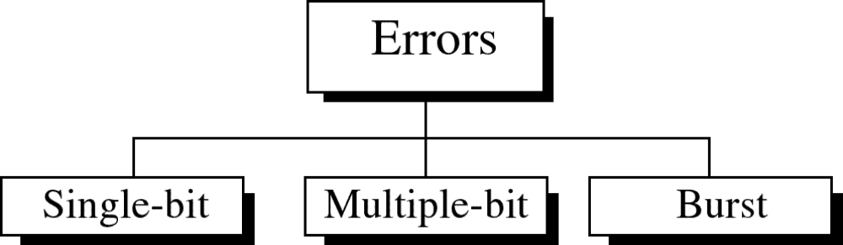
Types of Errors

Slide 4
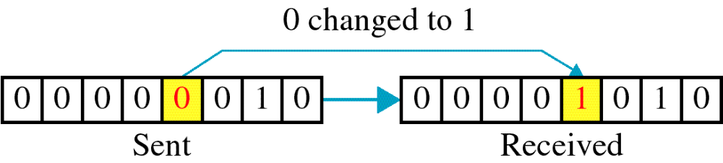
Single-bit error

Slide 5
Single bit errors are the least likely type of errors in serial data transmission because the noise must have a very short duration which is very rare. However this kind of errors can happen in parallel transmission.
Example:
If data is sent at 1Mbps then each bit lasts only 1/1,000,000 sec. or 1 μs.
For a single-bit error to occur, the noise must have a duration of only 1 μs, which is very rare.

Slide 6
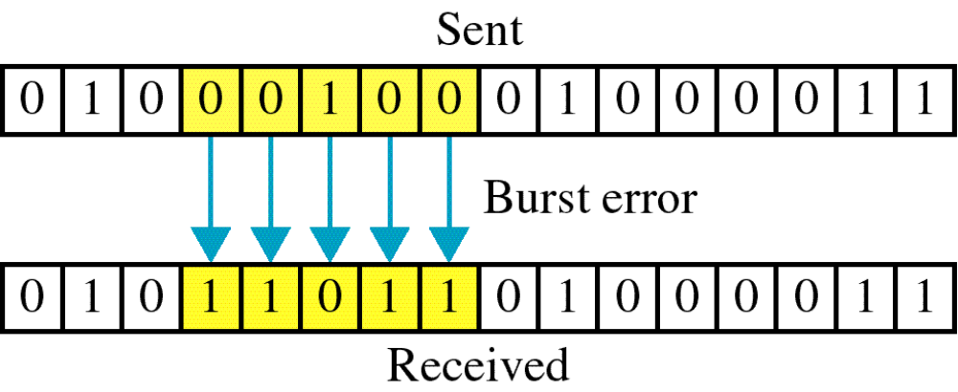
Burst error

Slide 7
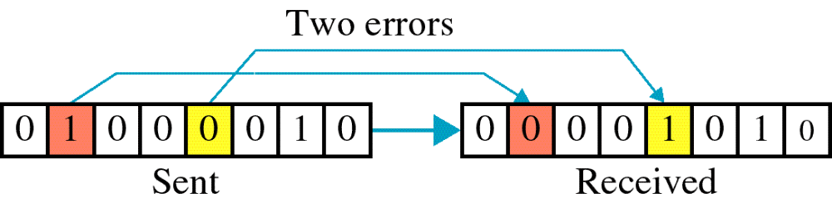

Slide 8
The term burst error means that two or more bits in the data unit have changed from 1 to 0 or from 0 to 1.
Burst errors does not necessarily mean that the errors occur in consecutive bits, the length of the burst is measured from the first corrupted bit to the last corrupted bit. Some bits in between may not have been corrupted.

Slide 9
Burst error is most likely to happen in serial transmission since the duration of noise is normally longer than the duration of a bit.
The number of bits affected depends on the data rate and duration of noise.
Example:
If data is sent at rate = 1Kbps then a noise of 1/100 sec can affect 10 bits.(1/100*1000)
If same data is sent at rate = 1Mbps then a noise of 1/100 sec can affect 10,000 bits.(1/100*10⁶)

Slide 10
Error detection
Error detection means to decide whether the received data is correct or not without having a copy of the original message.
Error detection uses the concept of redundancy, which means adding extra bits for detecting errors at the destination.
Notes:
Make sense of message.
Make sense of message.

Slide 11
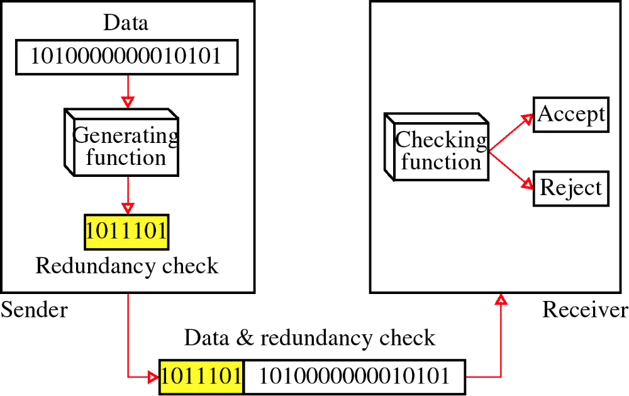
Redundancy

Slide 12
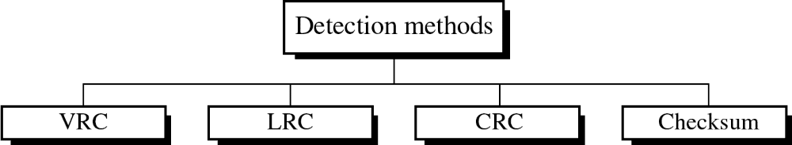
Four types of redundancy checks are used
in data communications

Slide 13
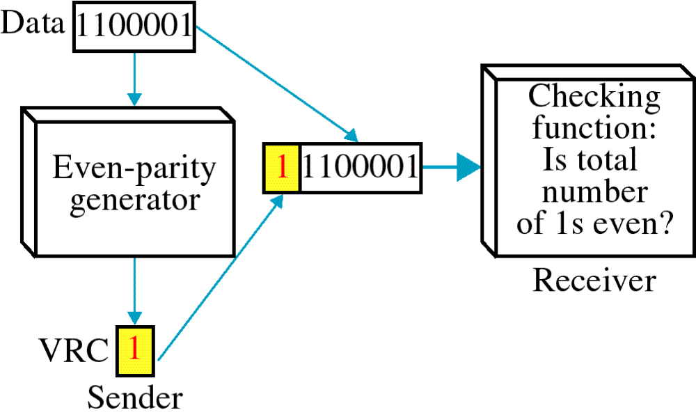
Vertical Redundancy Check
VRC

Slide 14
Performance
It can detect single bit error
It can detect burst errors only if the total number of errors is odd.

Slide 15
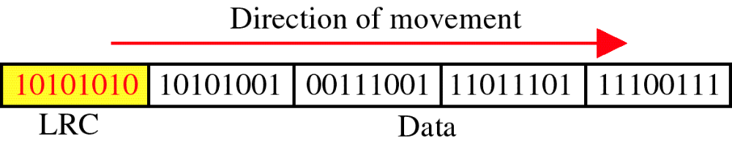
Longitudinal Redundancy Check
LRC

Slide 16
Performance
LCR increases the likelihood of detecting burst errors.
If two bits in one data units are damaged and two bits in exactly the same positions in another data unit are also damaged, the LRC checker will not detect an error.

Slide 17
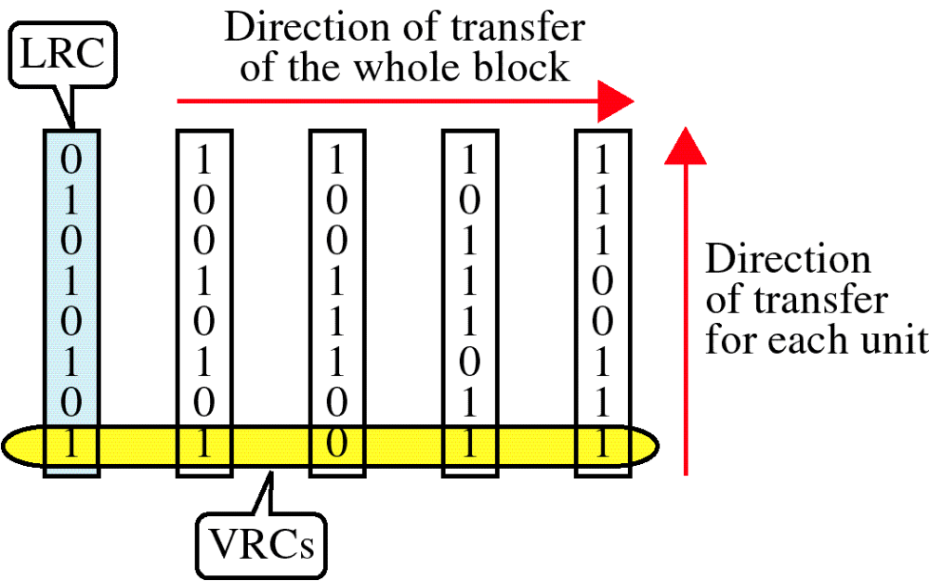
VRC and LRC

Slide 18
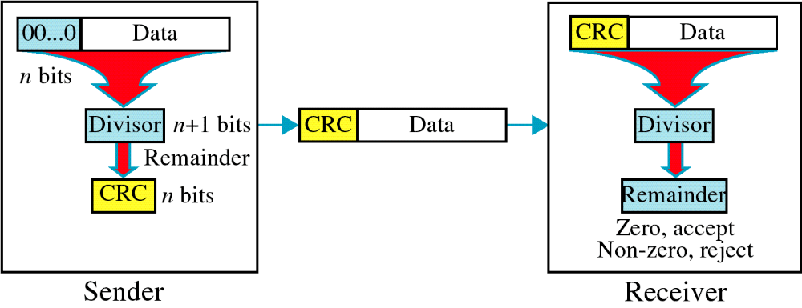
Cyclic Redundancy Check
CRC

Slide 19
Cyclic Redundancy Check
Given a k-bit frame or message, the transmitter generates an n-bit sequence, known as a frame check sequence (FCS), so that the resulting frame, consisting of (k+n) bits, is exactly divisible by some predetermined number.
The receiver then divides the incoming frame by the same number and, if there is no remainder, assumes that there was no error.

Slide 20
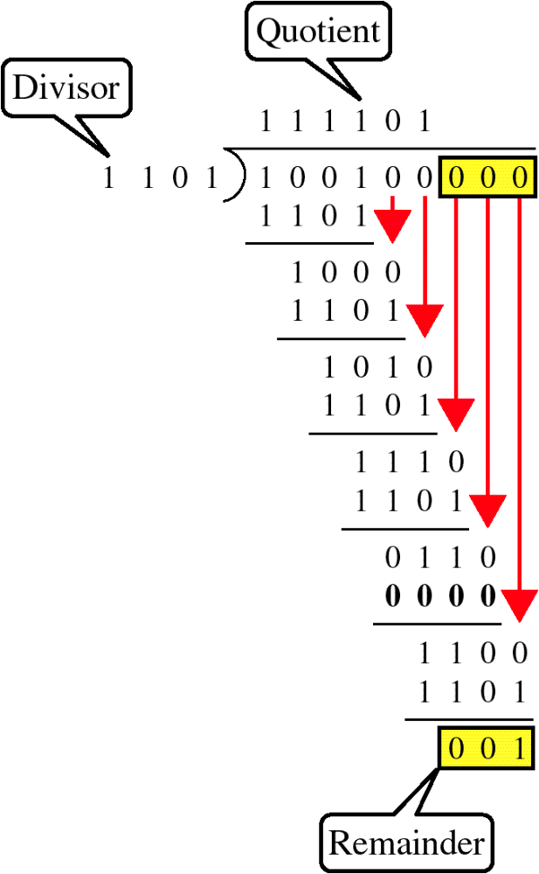
Binary Division

Slide 21
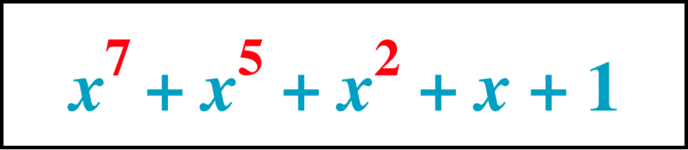
Polynomial

Slide 22
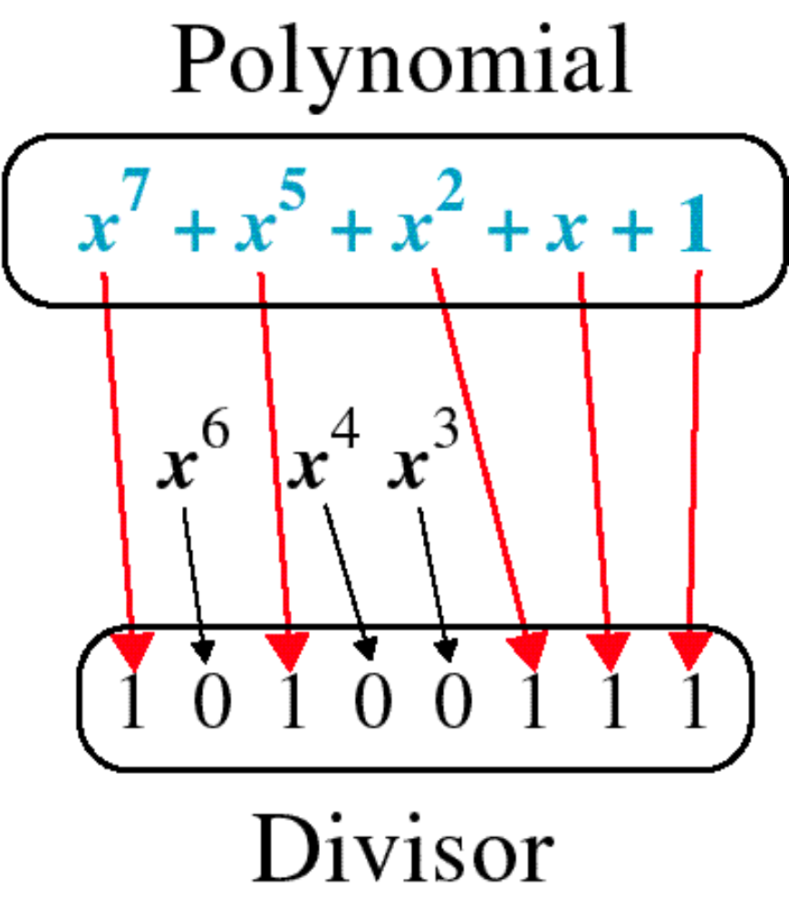
Polynomial and Divisor

Slide 23
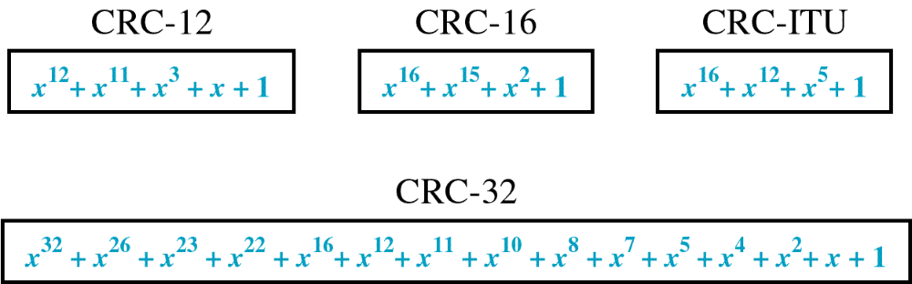
Standard Polynomials

Slide 24
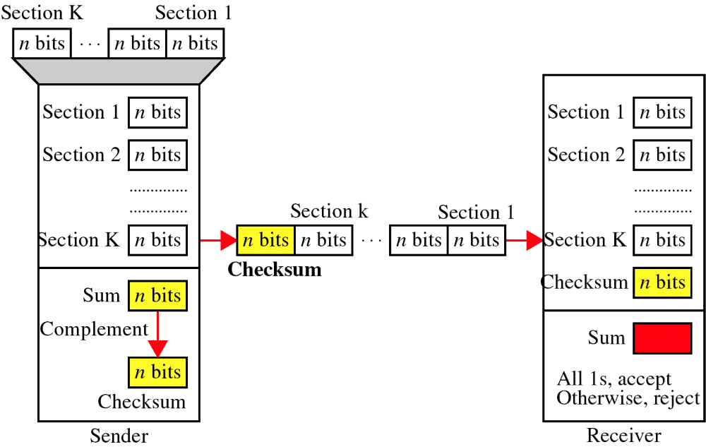
Checksum

Slide 25
At the sender
The unit is divided into k sections, each of n bits.
All sections are added together using one’s complement to get the sum.
The sum is complemented and becomes the checksum.
The checksum is sent with the data

Slide 26
At the receiver
The unit is divided into k sections, each of n bits.
All sections are added together using one’s complement to get the sum.
The sum is complemented.
If the result is zero, the data are accepted: otherwise, they are rejected.

Slide 27
Performance
The checksum detects all errors involving an odd number of bits.
It detects most errors involving an even number of bits.
If one or more bits of a segment are damaged and the corresponding bit or bits of opposite value in a second segment are also damaged, the sums of those columns will not change and the receiver will not detect a problem.

Slide 28
Error Correction
It can be handled in two ways:
receiver can have the sender retransmit the entire data unit.
The receiver can use an error-correcting code, which automatically corrects certain errors.

Slide 29
Single-bit error correction
To correct an error, the receiver reverses the value of the altered bit. To do so, it must know which bit is in error.
Number of redundancy bits needed
Let data bits = m
Redundancy bits = r
∴Total message sent = m+r
The value of r must satisfy the following relation:
2^{r} ≥ m+r+1

Slide 30
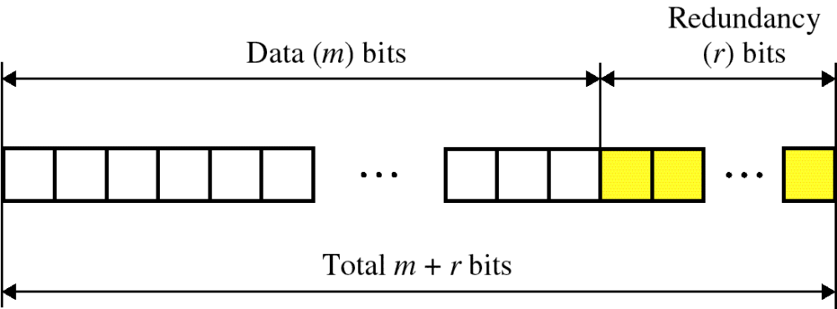
Error Correction

Slide 31
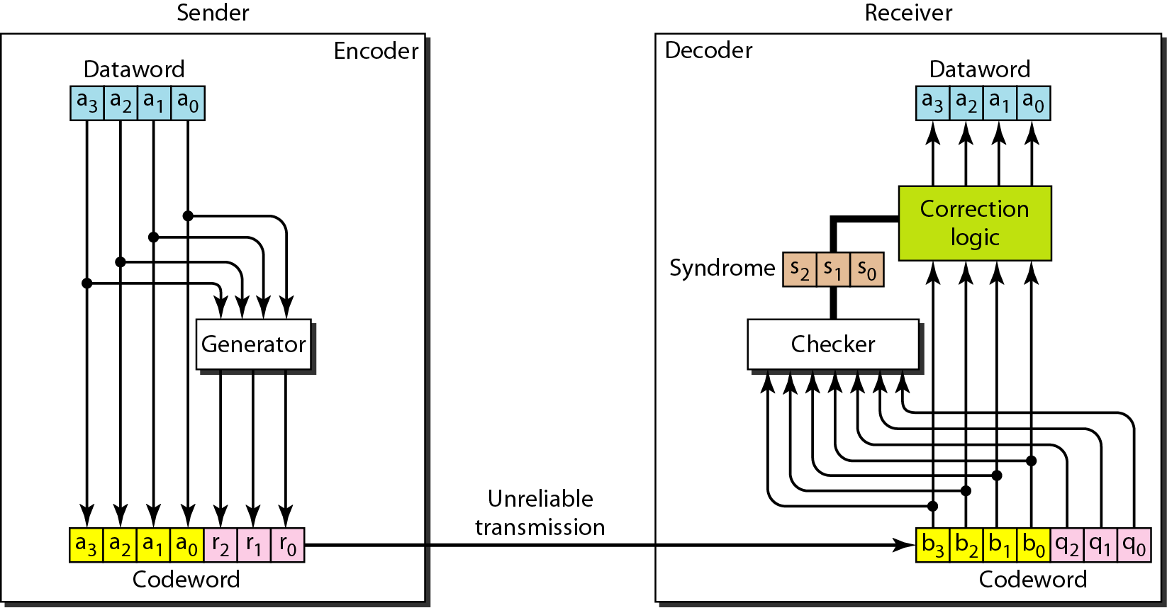
Figure 10.12 The structure of the encoder and decoder for a Hamming code

Slide 32
Hamming Code
Parity checks are created as follow (using modulo-2)
  r0 = a2 + a1 + a0
  r1 = a3 + a2 + a1
  r2 = a1 + a0 + a3

Slide 33
Hamming Code
The checker in the decoder creates a 3-bit syndrome (s2s1s0).
In which each bit is the parity check for 4 out of the 7 bits in the received codeword:
s0 = b2 + b1 + b0 + q0
s1 = b3 + b2 + b1 + q1
s2 = b1 + b0 + b3 + q2
The equations used by the checker are the same as those used by the generator with the parity-check bits added to the right-hand side of the equation.

Slide 34
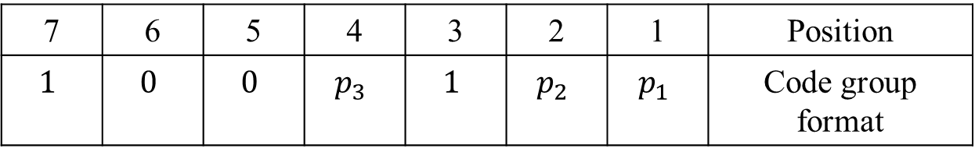
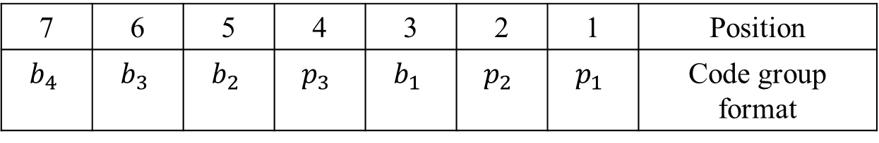
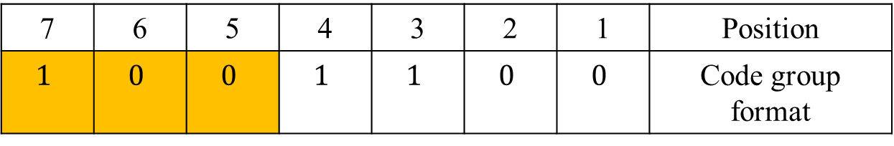
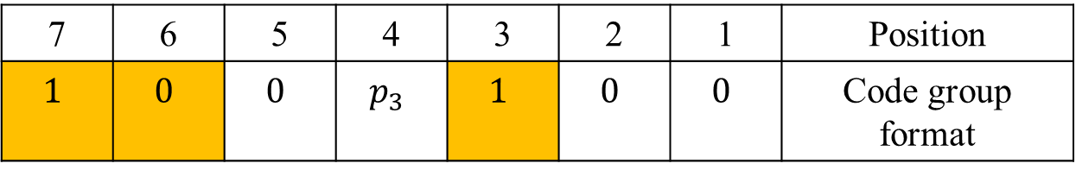
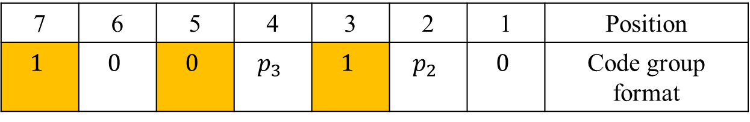
Example of Hamming Code for message length 4
7 | 6 | 5 | 4 | 3 | 2 | 1 | Position
$$b_{4}$$ | $$b_{3}$$ | $$b_{2}$$ | $$p_{3}$$ | $$b_{1}$$ | $$p_{2}$$ | $$p_{1}$$ | Code group format
7 | 6 | 5 | 4 | 3 | 2 | 1 | Position
$$1$$ | $$0$$ | $$0$$ | $$p_{3}$$ | $$1$$ | $$p_{2}$$ | $$p_{1}$$ | Code group format
7 | 6 | 5 | 4 | 3 | 2 | 1 | Position
$$1$$ | $$0$$ | $$0$$ | $$p_{3}$$ | $$1$$ | $$p_{2}$$ | $$0$$ | Code group format
7 | 6 | 5 | 4 | 3 | 2 | 1 | Position
$$1$$ | $$0$$ | $$0$$ | $$p_{3}$$ | $$1$$ | $$0$$ | $$0$$ | Code group format
7 | 6 | 5 | 4 | 3 | 2 | 1 | Position
$$1$$ | $$0$$ | $$0$$ | $$1$$ | $$1$$ | $$0$$ | $$0$$ | Code group format

Slide 35
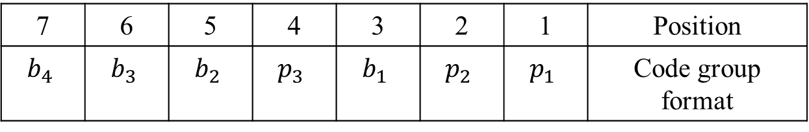
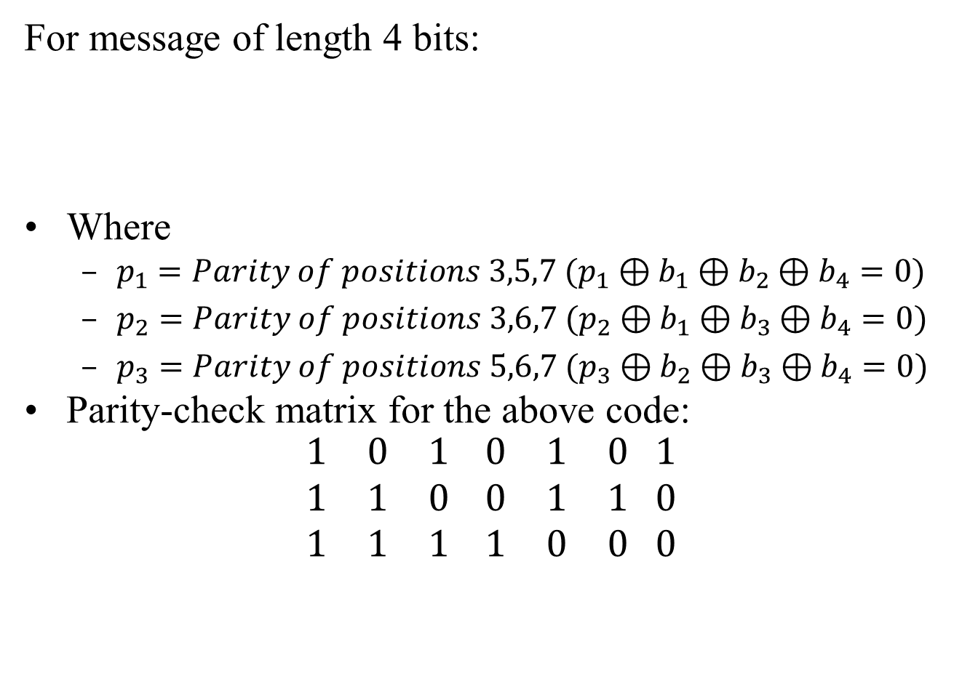
Which bit is flipped?
For message of length 4 bits:
Where
  $p_{1}=Parity of positions 3,5,7 (p_{1}⊕b_{1}⊕b_{2}⊕b_{4}=0)$
  $p_{2}=Parity of positions 3,6,7 (p_{2}⊕b_{1}⊕b_{3}⊕b_{4}=0)$
  $p_{3}=Parity of positions 5,6,7 (p_{3}⊕b_{2}⊕b_{3}⊕b_{4}=0)$
Parity-check matrix for the above code:
$$\begin{matrix}1 & 0 & 1 \\ 1 & 1 & 0 \\ 1 & 1 & 1\end{matrix} \begin{matrix}0 & 1 & 0 \\ 0 & 1 & 1 \\ 1 & 0 & 0\end{matrix} \begin{matrix}1 \\ 0 \\ 0\end{matrix}$$
7 | 6 | 5 | 4 | 3 | 2 | 1 | Position
$$b_{4}$$ | $$b_{3}$$ | $$b_{2}$$ | $$p_{3}$$ | $$b_{1}$$ | $$p_{2}$$ | $$p_{1}$$ | Code group format

Slide 36
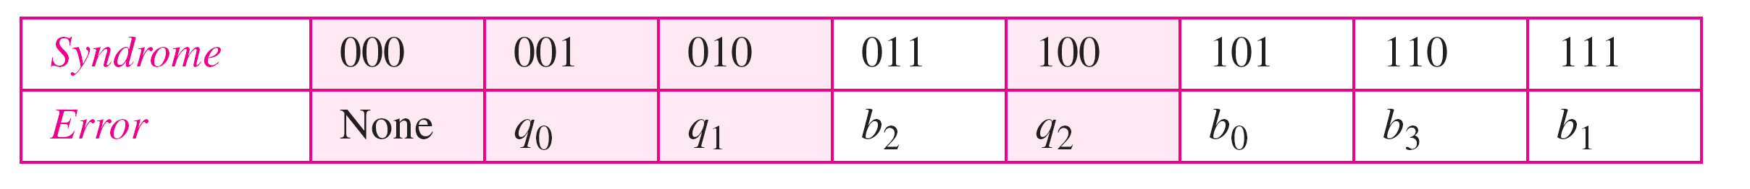
Table 10.5 Logical decision made by the correction logic analyzer
Hamming code C(7, 4) can :
detect up to 2-bit error (d_{min} -1)
can correct up to 1 bit error (d_{min}-1)/2

